Slide 1
Maven Fundamentals
COURSE OVERVIEW

Slide 2
Introduction
Key Concepts
Day-to-day coding Integration Complexities
Overview

Slide 3
Introduction to Maven
Structure Dependencies Repositories
Topics
Plugins
IDE Integration

Slide 4
Introduction to Maven

Slide 5
High Level Overview
Gradle VS Maven VS IDE Installation Best Practices Hello World Application Summary
Outline

Slide 6
Build Tool
One Artifact
Manage Dependencies
Project Management Tool
Handles Versioning/Releases
Describes Project
Produce Javadocs/Site Information
What is Maven

Slide 7
Apache Software Foundation
Maven is built with Maven Open Source
Who owns it

Slide 8
Repeatable builds
Transitive dependencies Environment
Why use it
Local repo
IDE and Standalone Preferred method

Slide 9
Official build tool for Android 2x in speed to that of Maven
Java and Groovy-based Domain-Specific Language (DSL) Interactive web-based UI
Gradle

Slide 10
Gradle Core Concepts
Projects
Tasks
Build Scripts

Slide 11
Why is Gradle Used?
Gradle resolves all the issues faced on other build tools like Maven and ANT.
The tool focuses on maintainability, usability, extendibility, performance, and flexibility.
It is well-known to be highly customizable when it comes to different projects dealing with various technologies. We may use Gradle in several ways, like Java projects, Android projects, and Groovy projects.
Gradle is popular as it provides high-speed performance, nearly twice as fast as Maven.
The tools support a wide variety of IDE's, which provide a better user experience, as different people prefer working on a different IDE. It provides the users that like to work on the terminal with the command-line interface, which offers features like Gradle tasks, Command line completion, etc.

Slide 12
Features of Gradle
High Performance
Provides Support
Multi-Project Build Software
Incremental Builds
Build Scans
Familiarity with Java

Slide 13
Full Featured
Implicit Consistency Inheritance
Maven
Transitive dependencies
Versioned

Slide 14
Differences between Gradle and Maven
Basis | Gradle | Maven
Based on | Gradle is based on developing domain-specific language projects. | Maven is based on developing pure Java language-based software.
Configuration | It uses a Groovy-based Domain-specific language(DSL) for creating project structure. | It uses Extensible Markup Language(XML) for creating project structure.
Focuses on | Developing applications by adding new features to them. | Developing applications in a given time limit.
Performance | It performs better than maven as it optimized for tracking only current running task. | It does not create local temporary files during software creation, and is hence – slower.
Java Compilation | It avoids compilation. | It is necessary to compile.
Usability | It is a new tool, which requires users to spend a lot of time to get used to it. | This tool is a known tool for many users and is easily available.
Customization | This tool is highly customizable as it supports a variety of IDE’s. | This tool serves a limited amount of developers and is not that customizable.
Languages supported | It supports software development in Java, C, C++, and Groovy. | It supports software development in Java, Scala, C#, and Ruby.
Project Configuration | For declaring the project configuration, it does not use the XML files. | For declaring the project configuration, it uses the XML files.
Based on | Graph of task dependencies that do the work. | On the phases of the fixed and linear model.
Goal | To add functionality in the project is the main goal of the Gradle. | To finish the project in the given timeline is the main goal of the Maven.

Slide 15
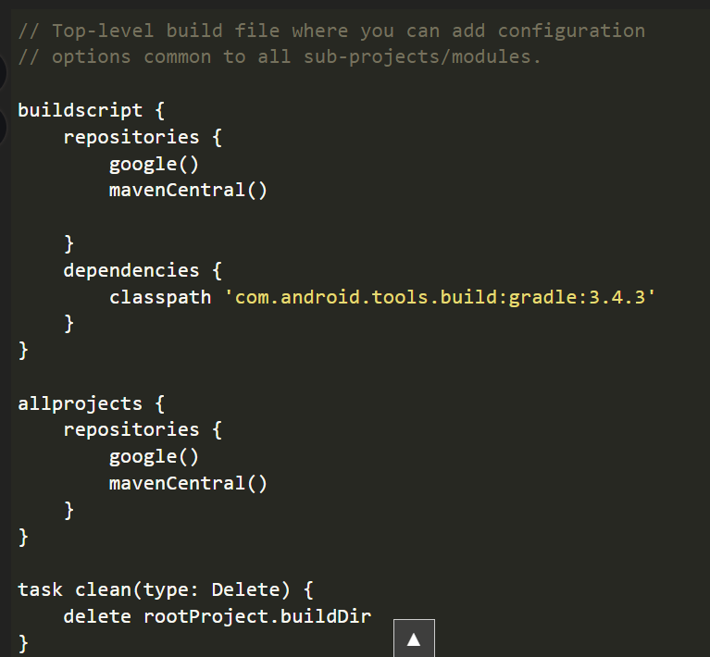
Gradle

Slide 16
Maven
<project>
<modelVersion>4.0.0</modelVersion>
<groupId>com.mycompany</groupId>
<artifactId>FitnessTracker</artifactId>
<version>0.0.1-SNAPSHOT</version>
<name>HelloWorld</name>
</project>

Slide 17
Java 10+
<build>
<plugins>
<plugin>
<groupId>org.apache.maven.plugins</groupId>
<artifactId>maven-compiler-plugin</artifactId>
<version>3.8.0</version>
<configuration>
<release>10</release>
</configuration>
</plugin>
</plugins>
</build>

Slide 18

Summary
Maven convention Gradle vs.Maven
Maven project lifecycle

